Slide 1


Solar wind data assimilation in an operational context
Use of near-real-time data and the forecast value of an L5 monitor
Harriet Turner
Supervisors: Mathew Owens, Matthew Lang, Mike Marsh and Siegfried Gonzi

Slide 2
THE SOLAR WIND
Constant stream of charged particles that flows off the Sun and fills the heliosphere (solar system)
Comprised mostly of electrons, protons and ions

Slide 3
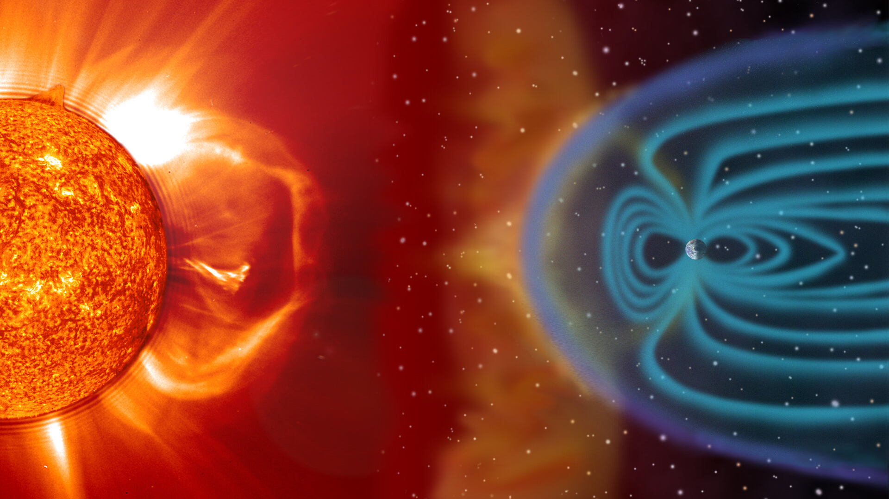
TITLE
Text

Slide 4
TITLE
Text
*Not to scale

Slide 5
SOLAR WIND STRUCTURE
Solar wind drags out the Sun’s magnetic field
Pulled into an Archimedean spiral due to the Sun’s rotation
Solar wind flow is mostly radial

Slide 6
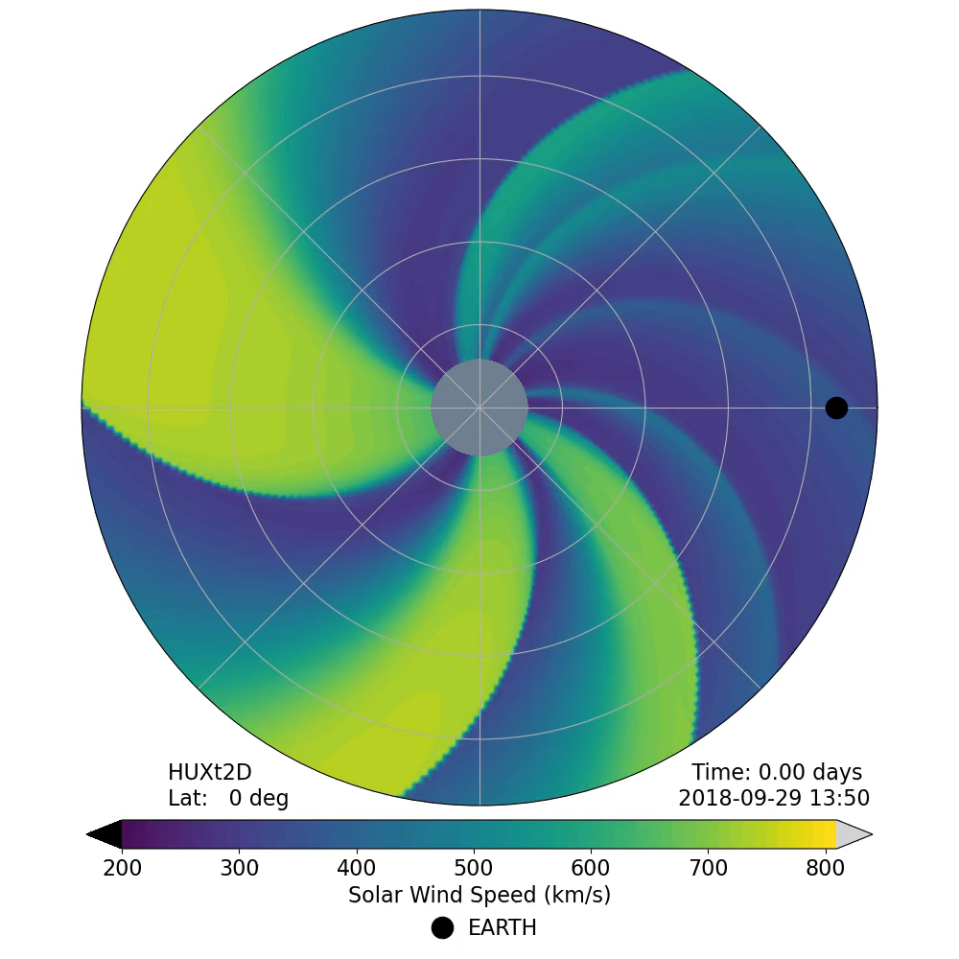

Slide 7
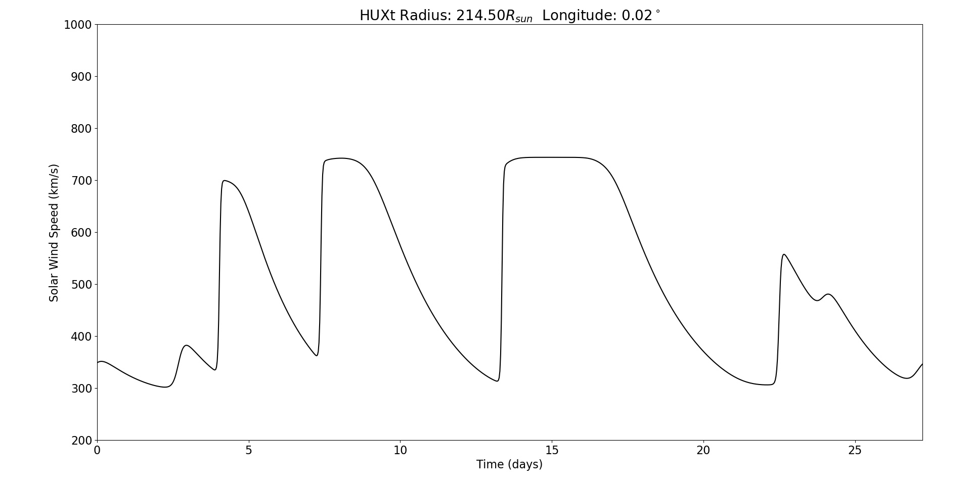
AS A TIME SERIES

Slide 8
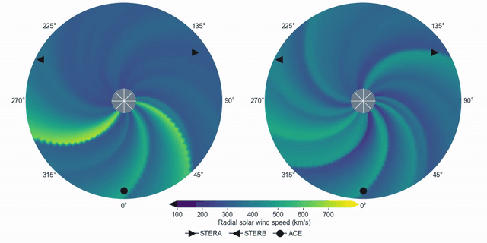
CORONAL MASS EJECTIONS
Coronal mass ejections (CMEs) are huge eruptions of solar material and are the main driver of severe space weather
They propagate through the solar wind, so the background conditions affect their speed and arrival time

Slide 9
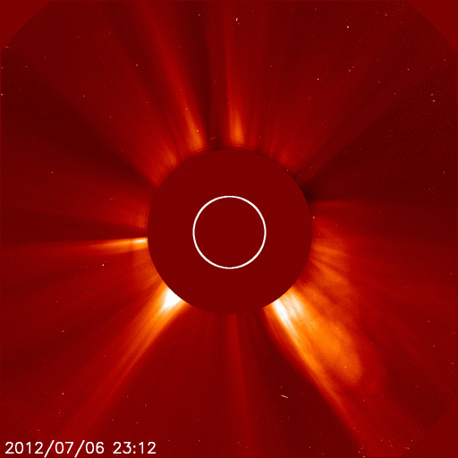
TITLE
Text

Slide 10
WHY SHOULD WE CARE?
Space weather (the changing plasma conditions in near-Earth space) poses a significant threat to modern technology
Extreme space weather is in the UK’s National Risk Register

Slide 11
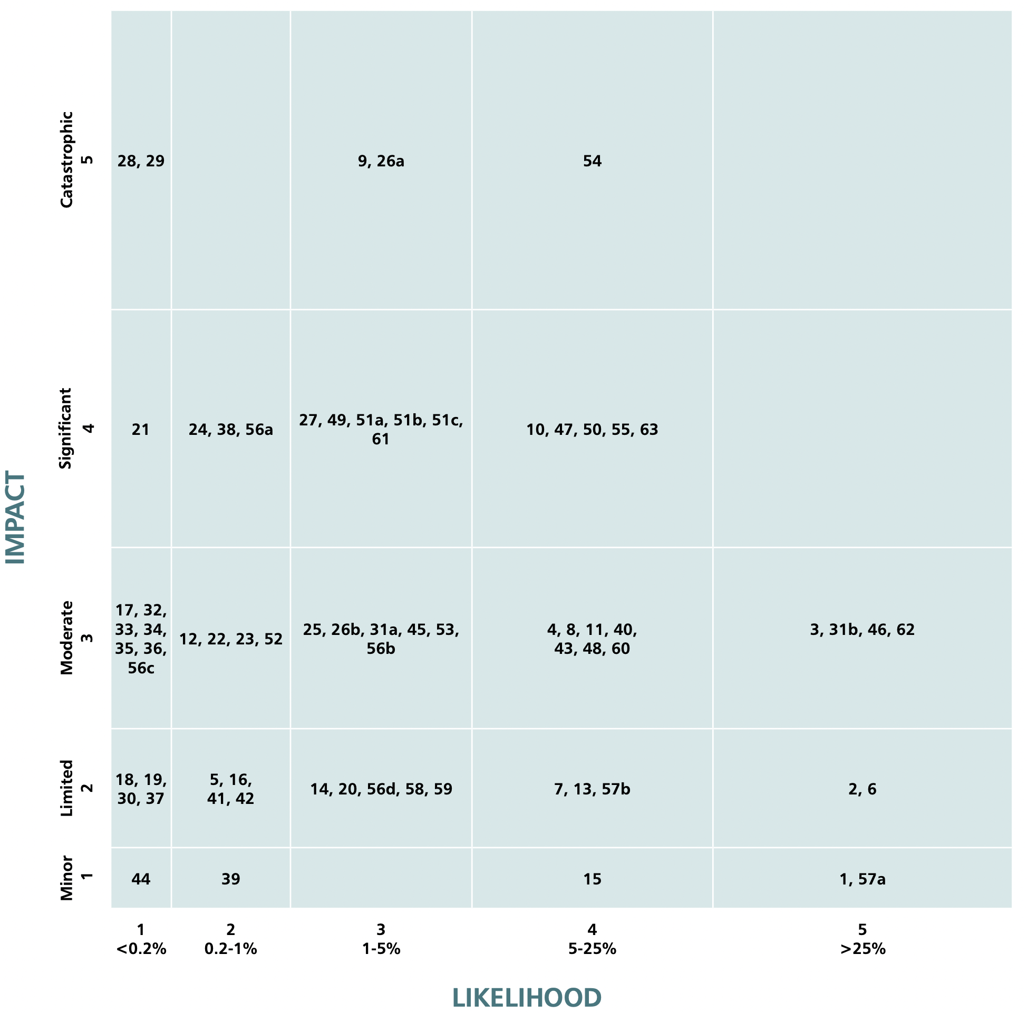

Slide 12
Pandemics

Slide 13
Coastal and river flooding

Slide 14
Heatwaves

Slide 15
Severe space weather

Slide 16
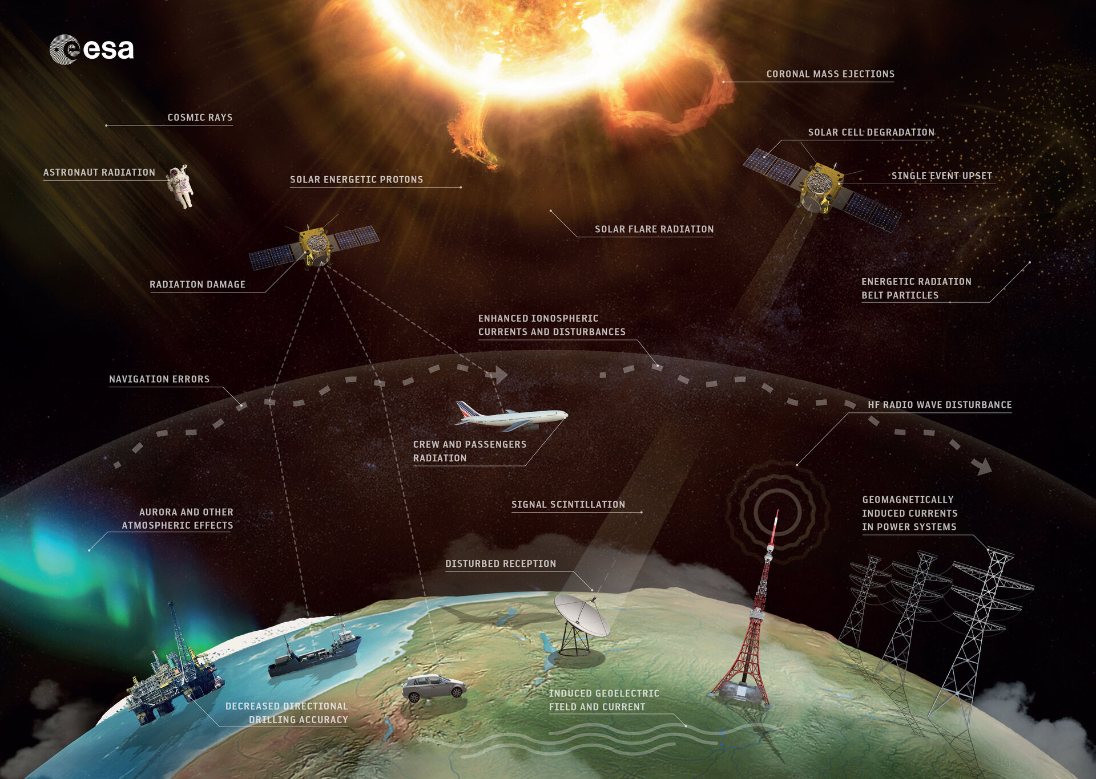
TITLE
Text

Slide 17
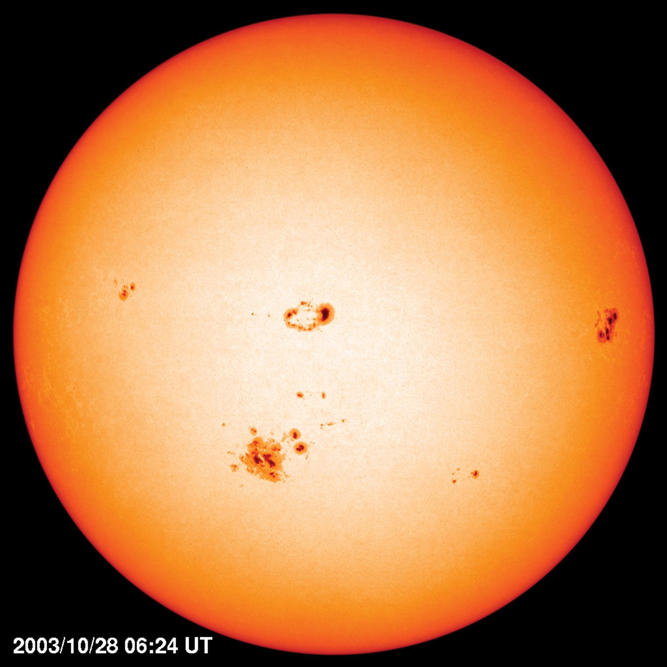
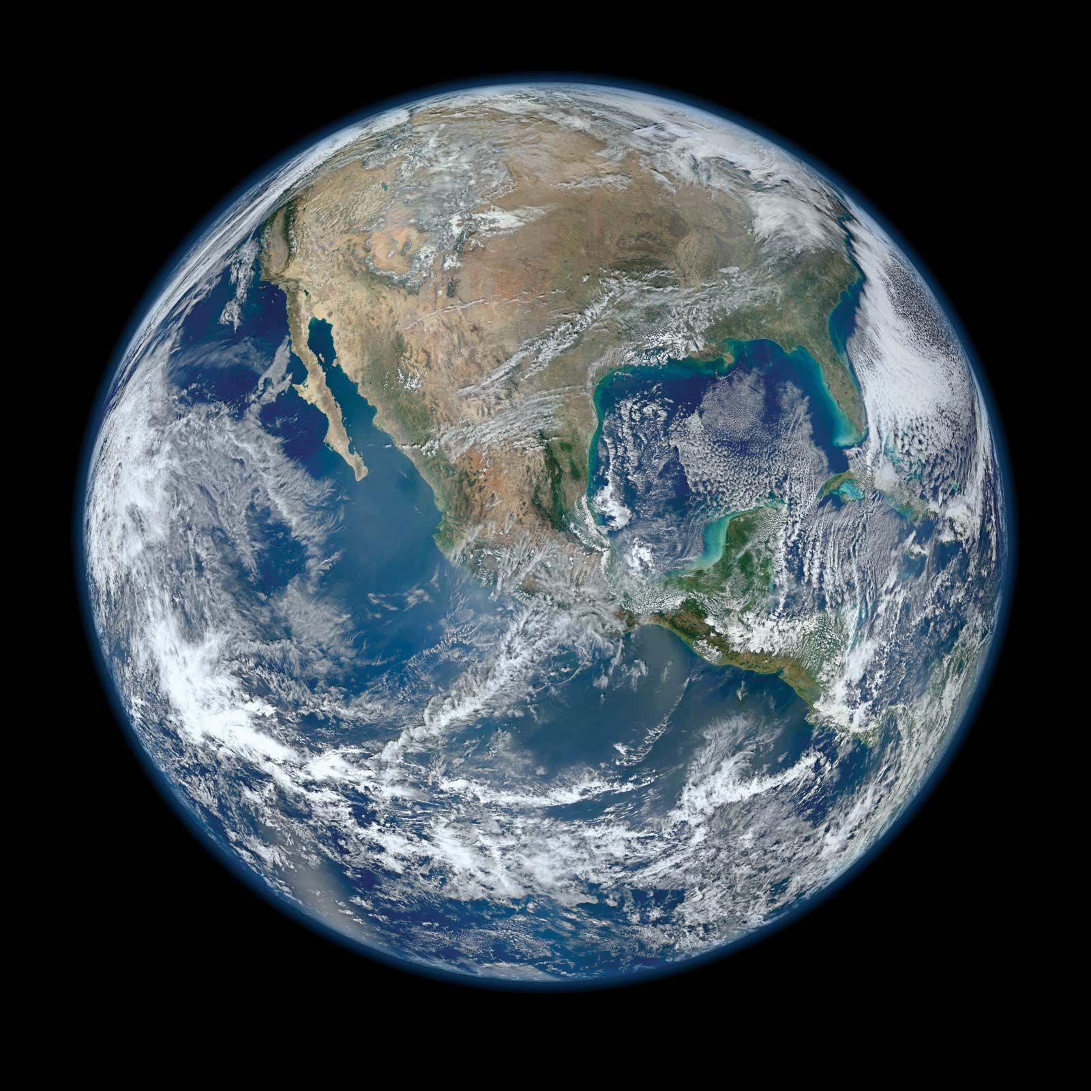
CURRENT FORECASTING
Typically a coronal model coupled to a heliospheric model
1 AU

Slide 18
CURRENT FORECASTING
Typically a coronal model coupled to a heliospheric model
1 AU

Slide 19
CURRENT FORECASTING
Typically a coronal model coupled to a heliospheric model
Photospheric observations
1 AU

Slide 20
CURRENT FORECASTING
Typically a coronal model coupled to a heliospheric model
WSA
1 AU

Slide 21
CURRENT FORECASTING
Typically a coronal model coupled to a heliospheric model
0.1 AU
1 AU

Slide 22
CURRENT FORECASTING
Typically a coronal model coupled to a heliospheric model
0.1 AU
1 AU

Slide 23
CURRENT FORECASTING
Typically a coronal model coupled to a heliospheric model
V
0.1 AU
1 AU

Slide 24
CURRENT FORECASTING
Typically a coronal model coupled to a heliospheric model
V
0.1 AU
B
1 AU

Slide 25
CURRENT FORECASTING
Typically a coronal model coupled to a heliospheric model
V
0.1 AU
B
1 AU

Slide 26
CURRENT FORECASTING
Typically a coronal model coupled to a heliospheric model
V
0.1 AU
Enlil
B
1 AU

Slide 27
CURRENT FORECASTING
Typically a coronal model coupled to a heliospheric model
V
V
B
0.1 AU
Enlil
n
B
T
1 AU

Slide 28
CURRENT FORECASTING
Typically a coronal model coupled to a heliospheric model
V
V
B
0.1 AU
Enlil
n
B
T
1 AU

Slide 29
DATA ASSIMILATION (DA)
Data assimilation combines prior information, usually from a model, with observations to find an optimum estimation of reality
Used in numerical weather prediction and has led to large forecast improvements
Underused in space weather

Slide 30
DA IN SPACE WEATHER
DA is in its infancy in space weather forecasting
Has been used in 3 main areas – the photosphere, solar wind and ionosphere

Slide 31
TITLE
Text
Ionosphere –
where Earth’s atmosphere reaches space
Photosphere – lowest layer of the Sun’s atmosphere that is observable
Solar wind

Slide 32
DA IN THE SOLAR WIND
I have been using the Burger Radius Variational Data Assimilation (BRaVDA) scheme developed at the University of Reading (Lang et al., 2019)
Combines observations with a steady-state solar wind model
Prior inner boundary condition from a coronal model

Slide 33


Slide 34
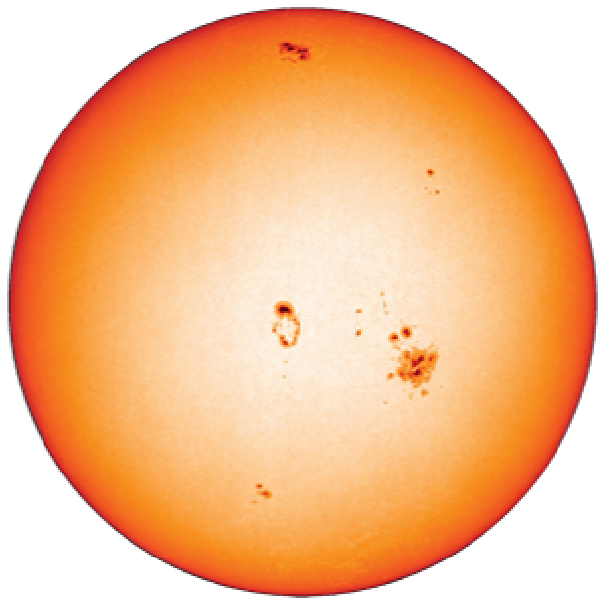

Slide 35
Time = t₀
= observation
Notes:
Assimilating a single observation

Slide 36

Time = t₀
= observation

Slide 37
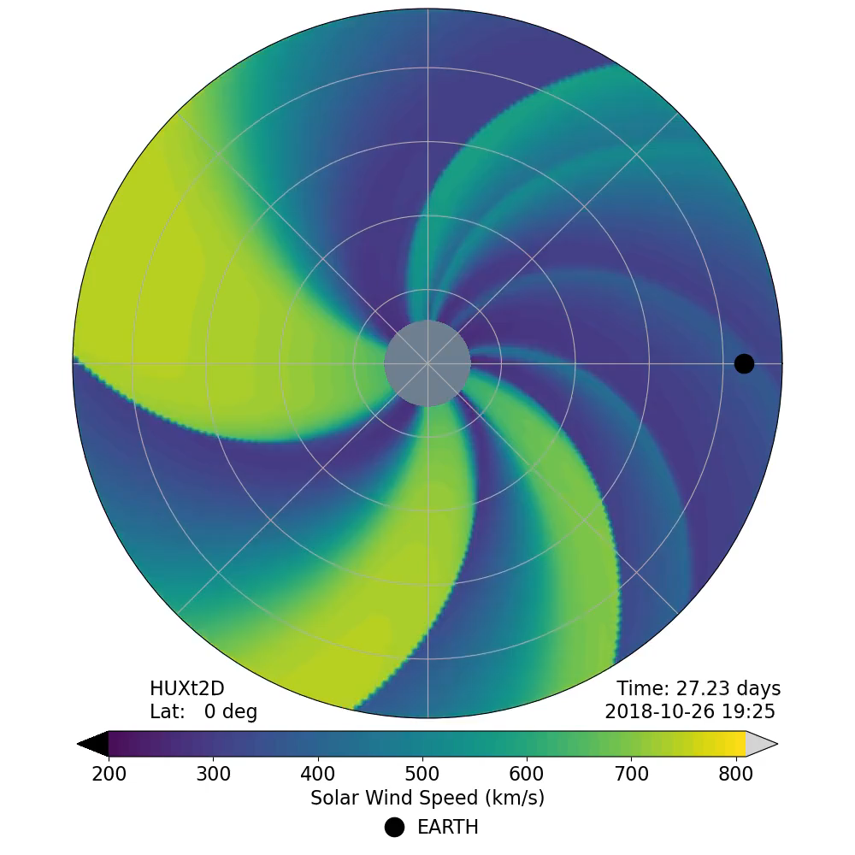
– Δt
Time = t₀
= observation

Slide 38
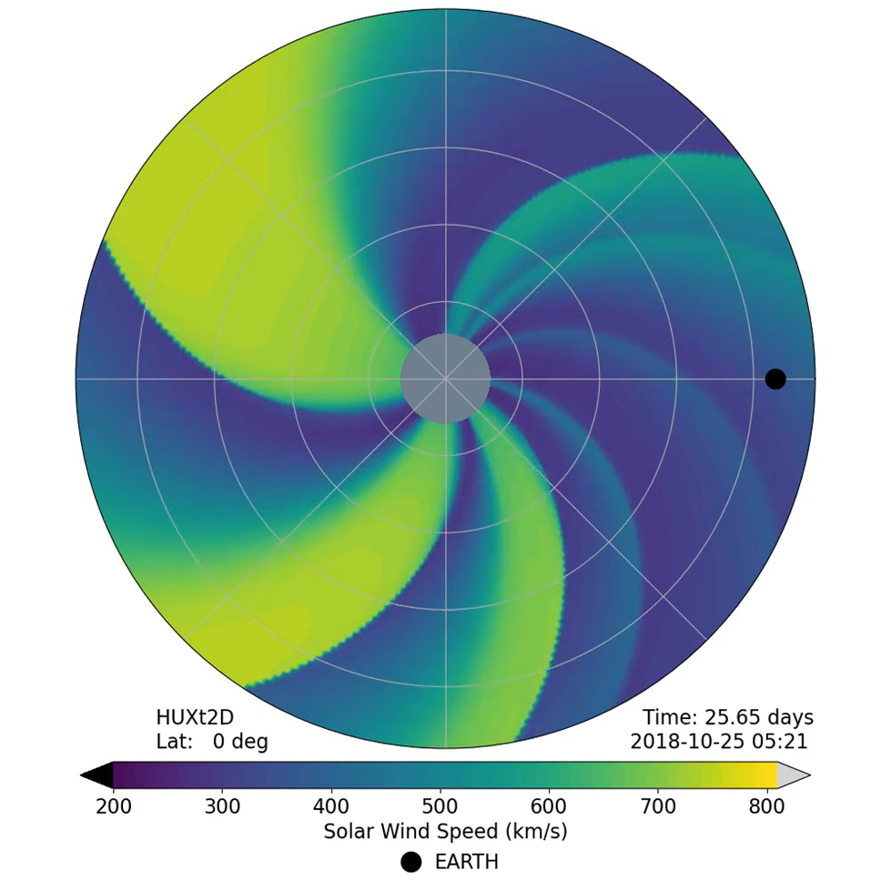
– Δt
Time = t₀
= observation

Slide 39
Time = t₀ – Δt
= observation

Slide 40
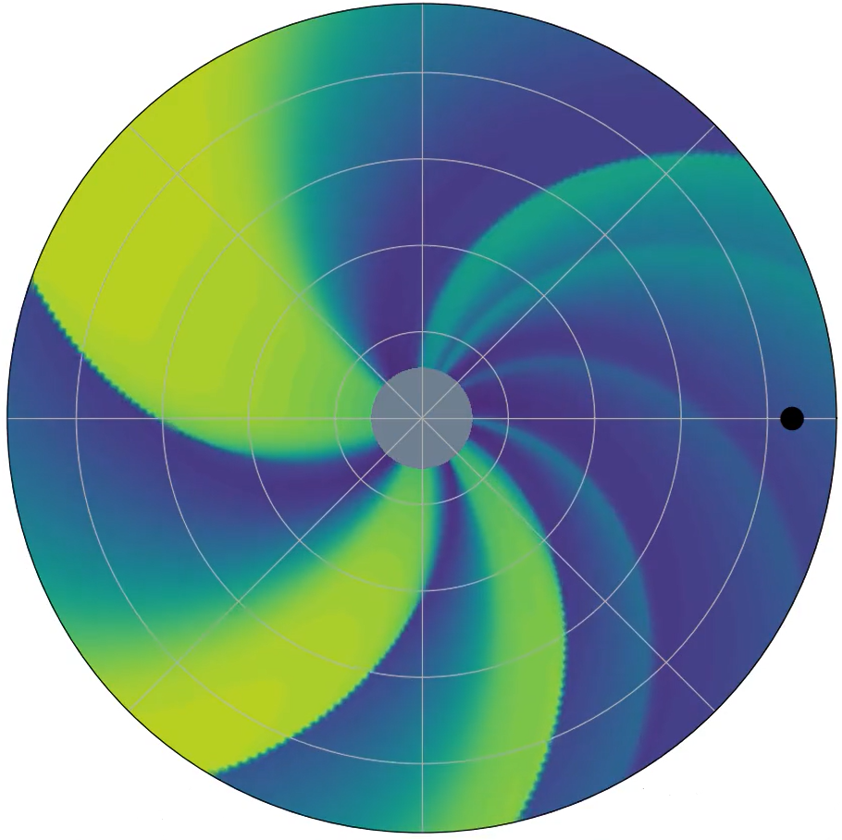
Time = t₀ – Δt
= observation

Slide 41
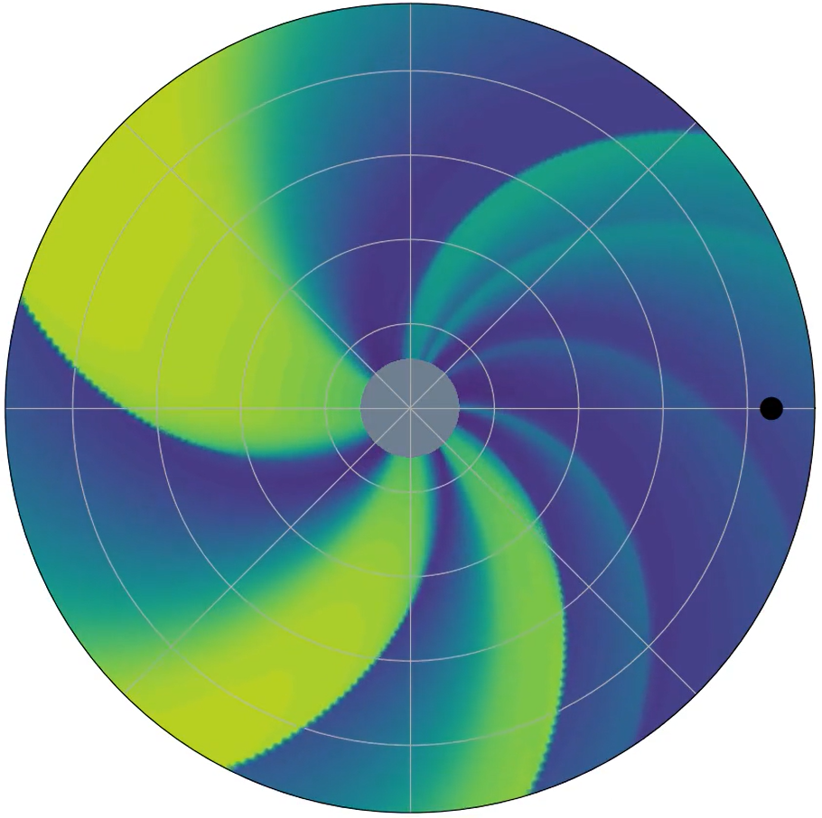
Time = t₀ – Δt
= observation

Slide 42
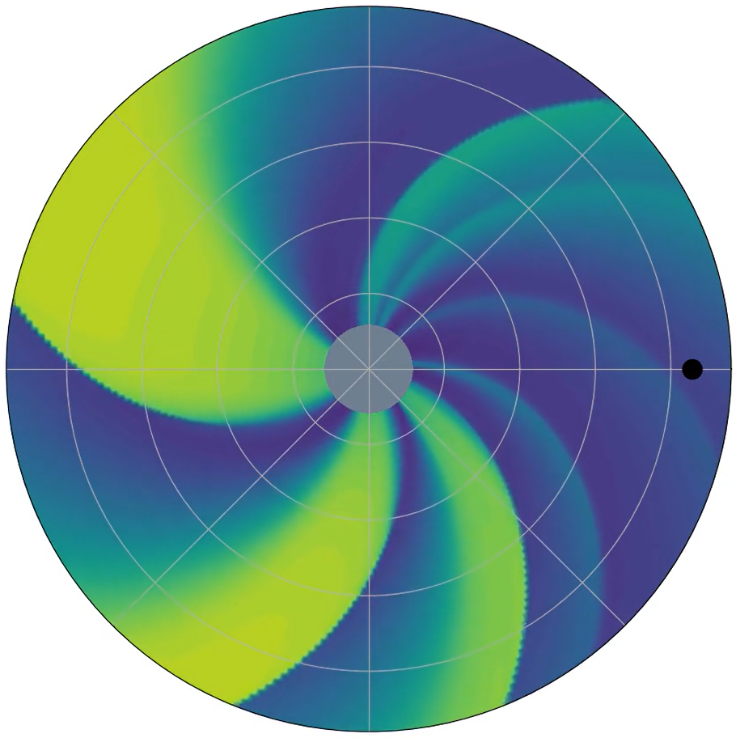
Time = t₀ – Δt
= observation

Slide 43
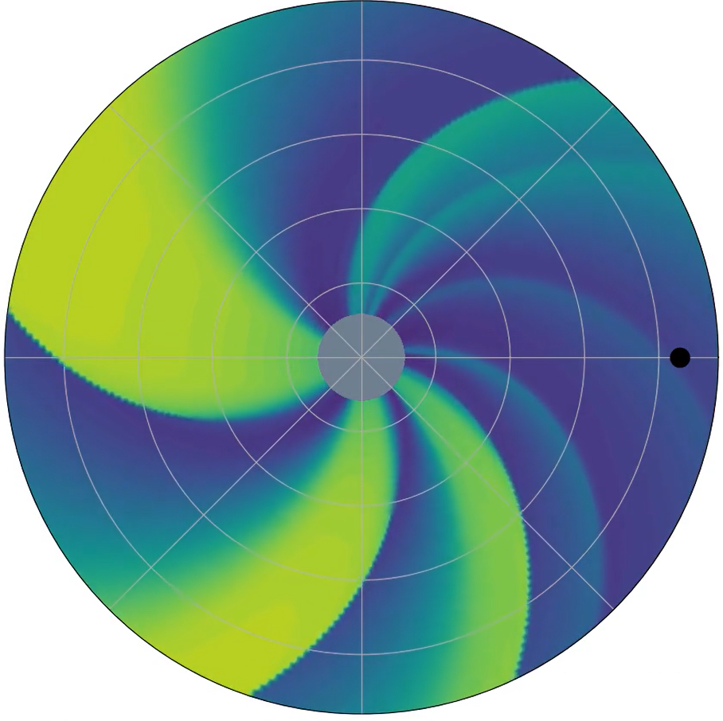
Time = t₀ – Δt
= observation

Slide 44
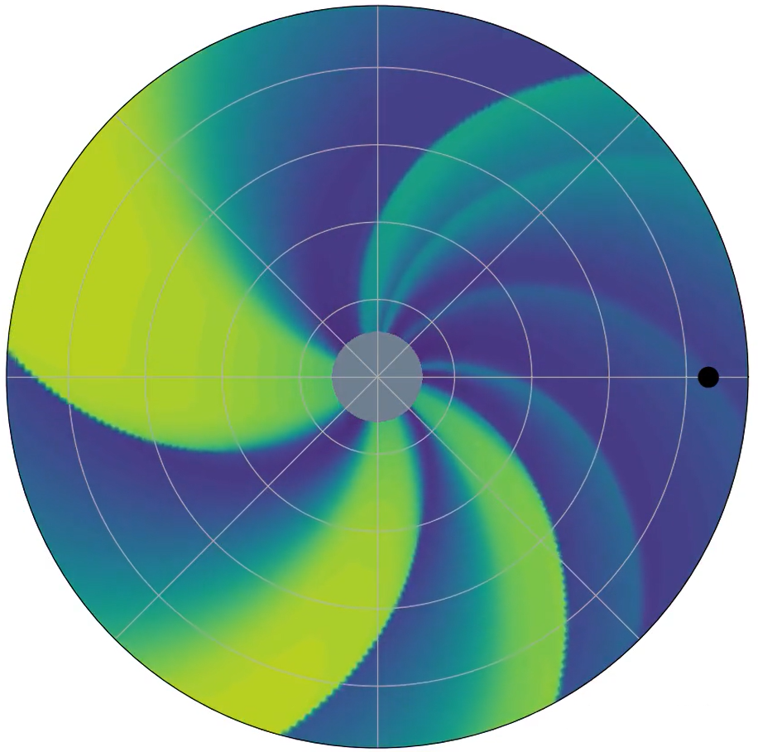
Time = t₀ – Δt
= observation

Slide 45
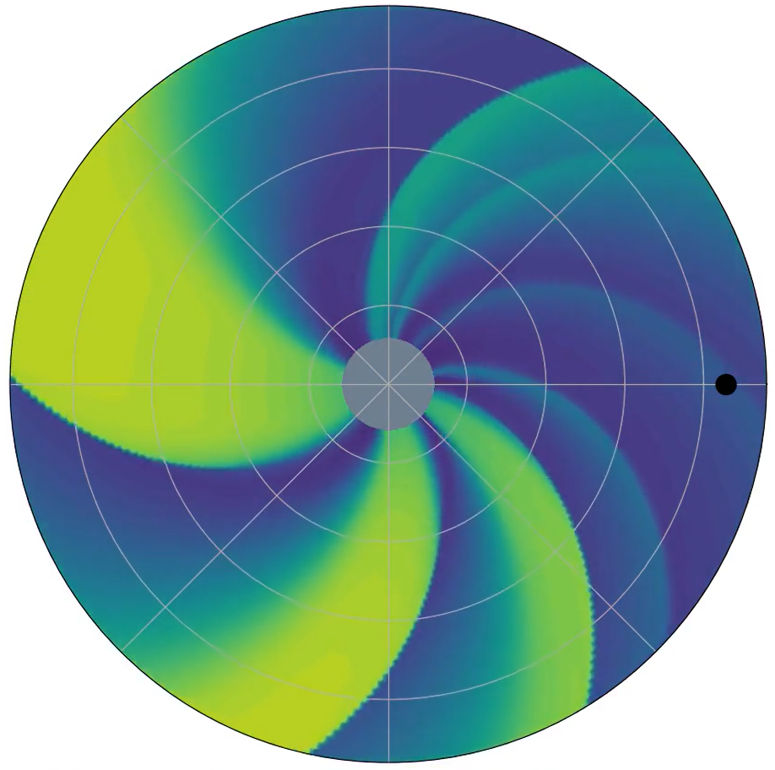
Time = t₀
= observation

Slide 46
Time = t₀
= observation

Slide 47
Time = t₀
= observation

Slide 48
Time = t₀
= observation

Slide 49
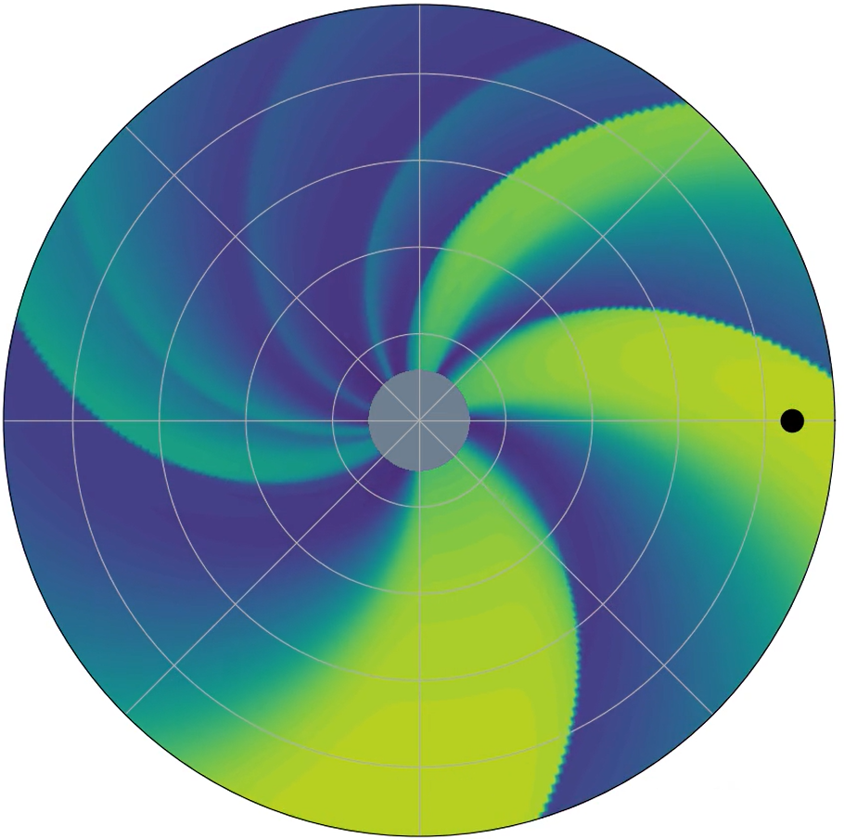
Time = t₀ + Δt
= observation

Slide 50
CURRENT FORECASTING
Typically a coronal model coupled to a heliospheric model
V
V
B
0.1 AU
Enlil
n
B
T
1 AU

Slide 51
CURRENT DA IMPLEMENTATION
Typically a coronal model coupled to a heliospheric model
V
0.1 AU
B
1 AU

Slide 52
CURRENT DA IMPLEMENTATION
Typically a coronal model coupled to a heliospheric model
V
BRaVDA
0.1 AU
B
1 AU

Slide 53
CURRENT DA IMPLEMENTATION
Typically a coronal model coupled to a heliospheric model
V_{obs}
V
BRaVDA
0.1 AU
B
1 AU

Slide 54
CURRENT DA IMPLEMENTATION
Typically a coronal model coupled to a heliospheric model
V_{obs}
V
BRaVDA
Solar wind reconstruction
0.1 AU
B
1 AU

Slide 55
DIVERGENCE OF METHODS
Previous work (Lang et al., 2021) have used the reduced-physics model “HUXt” (Owens et l., 2020) for analysis
For simplicity, I have used corotation – essentially assuming the Sun remains constant as it rotates

Slide 56
HUXt METHOD
Typically a coronal model coupled to a heliospheric model
V_{obs}
V
BRaVDA
0.1 AU
B
1 AU

Slide 57
HUXt METHOD
Typically a coronal model coupled to a heliospheric model
V_{obs}
V
BRaVDA
V_{updated}
0.1 AU
B
1 AU

Slide 58
HUXt METHOD
Typically a coronal model coupled to a heliospheric model
V_{obs}
V
BRaVDA
V_{updated}
0.1 AU
B
1 AU

Slide 59
HUXt METHOD
Typically a coronal model coupled to a heliospheric model
V_{obs}
V
BRaVDA
V_{updated}
0.1 AU
HUXt
B
1 AU

Slide 60
HUXt METHOD
Typically a coronal model coupled to a heliospheric model
V_{obs}
V
BRaVDA
V_{updated}
0.1 AU
HUXt
B
1 AU

Slide 61
COROTATION METHOD
Typically a coronal model coupled to a heliospheric model
V_{obs}
V
BRaVDA
0.1 AU
B
1 AU

Slide 62
COROTATION METHOD
Typically a coronal model coupled to a heliospheric model
V_{obs}
V
BRaVDA
V_{updated}
0.1 AU
B
1 AU

Slide 63
COROTATION METHOD
Typically a coronal model coupled to a heliospheric model
V_{obs}
V
BRaVDA
V_{updated}
0.1 AU
B
1 AU

Slide 64
OBSERVATIONS – STEREO
Solar Terrestrial Relations Observatory Ahead and Behind – STEREO-A and B
Earth-like orbits, but separating in longitude
Launched in 2007
Communication with STEREO-B lost in 2014

Slide 65
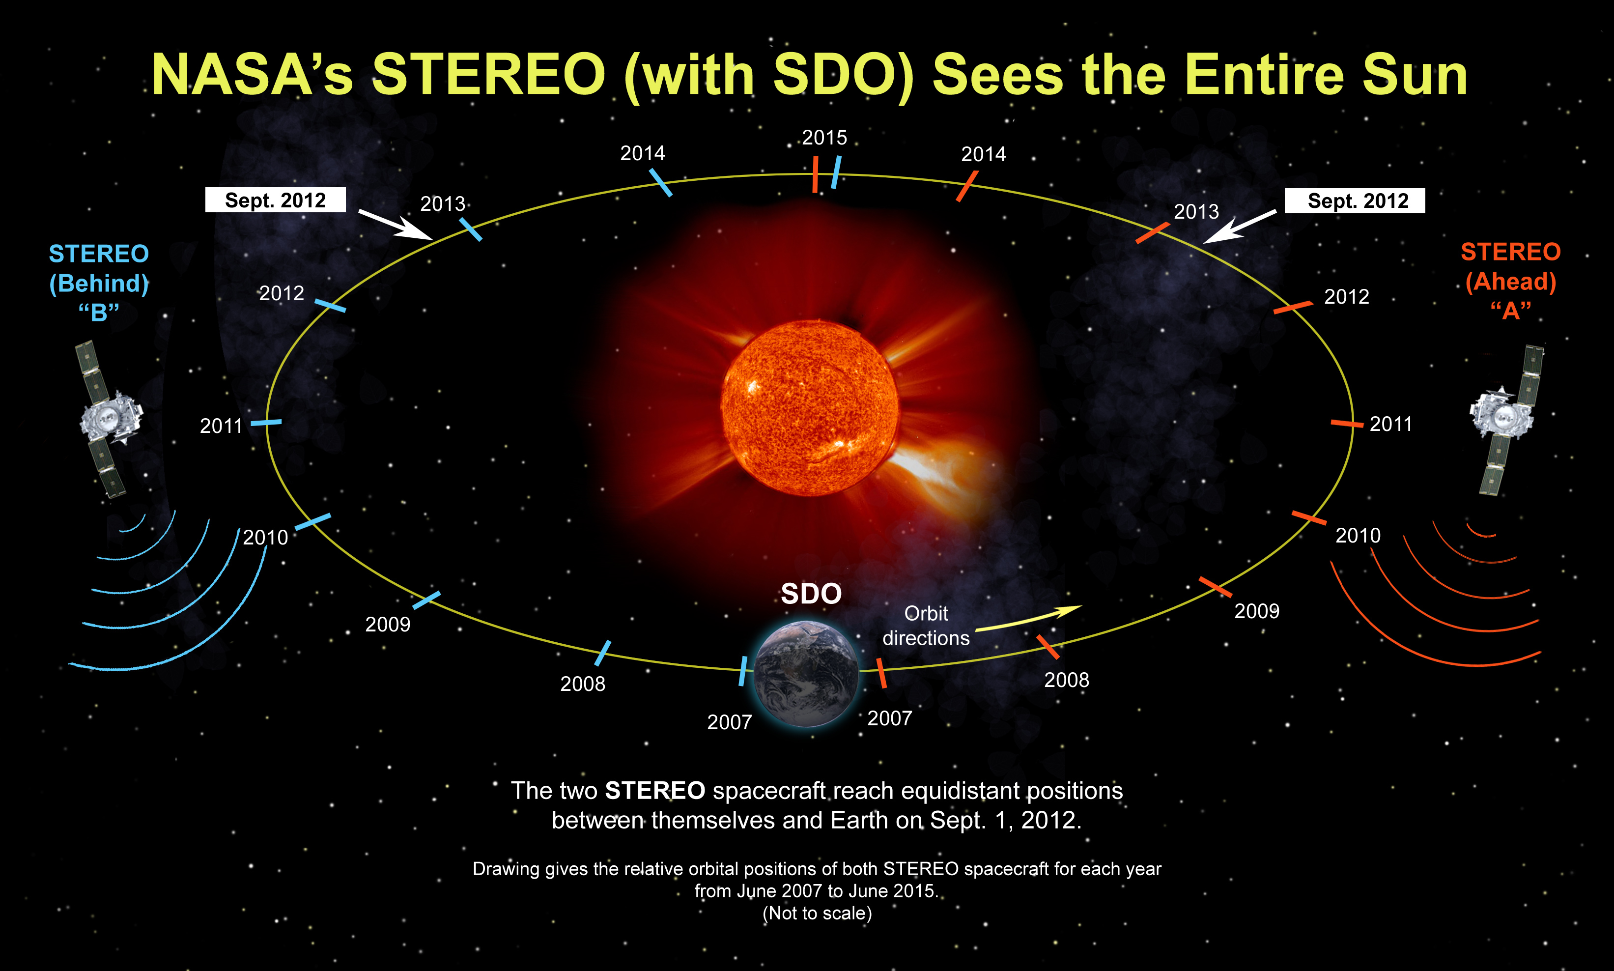
TITLE
Text

Slide 66
OBSERVATIONS – ACE & DSCOVR
Advanced Composition Explorer – ACE (launched 1997)
Deep Space Climate Observatory – DSCOVR (launched 2015)
Both give near-Earth observations from L1

Slide 67
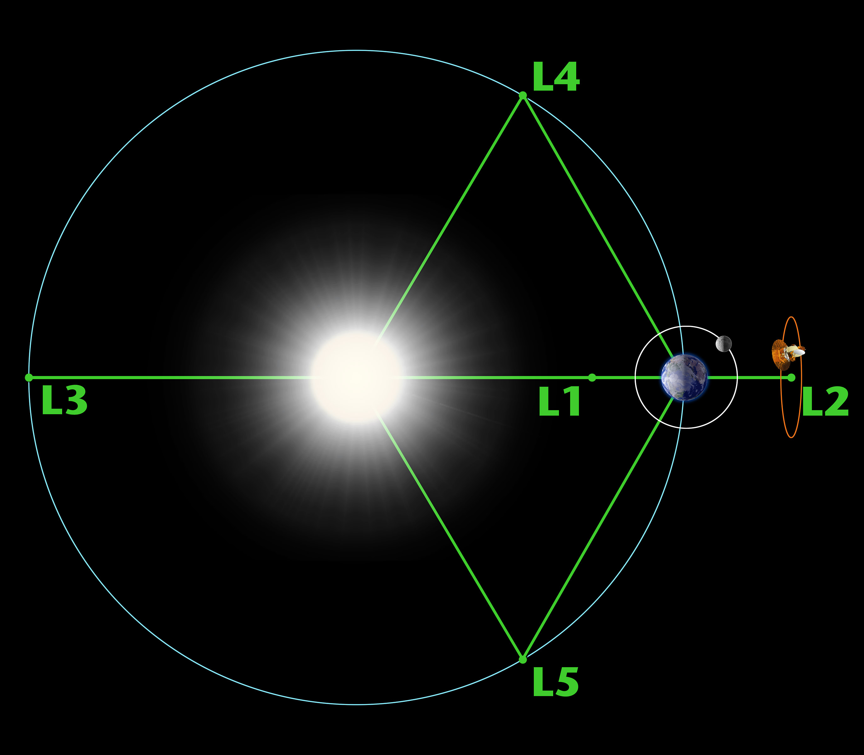
TITLE
Text

Slide 68
TITLE
Text
*Not to scale

Slide 69
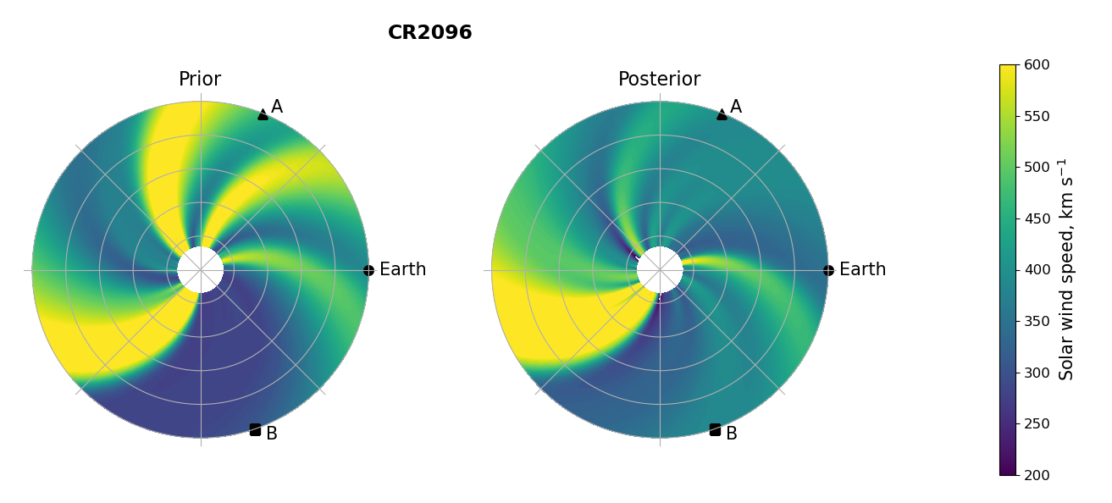
DA OUTPUT – POLAR

Slide 70
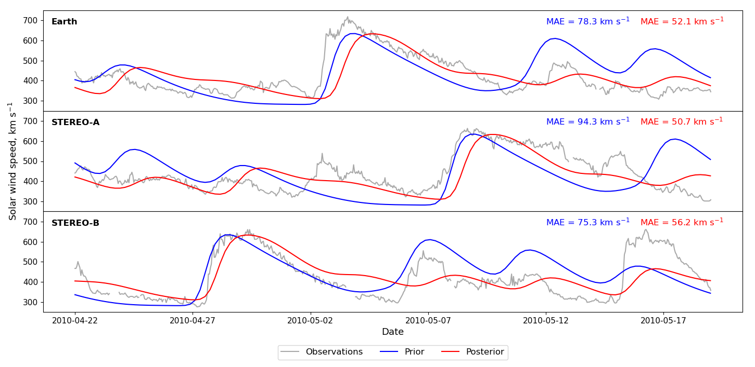
DA OUTPUT – TIME SERIES

Slide 71
FORECASTING USING OUTPUT
t - 27
t
t + 27

Slide 72
FORECASTING USING OUTPUT
Assimilation window
t - 27
t
t + 27

Slide 73
FORECASTING USING OUTPUT
Assimilation window
t - 27
t
t + 27

Slide 74
FORECASTING USING OUTPUT
Assimilation window
Forecast window
t - 27
t
t + 27

Slide 75
OPERATIONAL SOLAR WIND DA
For BRaVDA to be operational, it needs to work with real time data
Previous experiments have used science level data, which has been pre-processed to provide a “cleaner” dataset (e.g. Lang et al., 2021 and Turner et al., 2022)
Removing data gaps, erroneous observations and biases

Slide 76
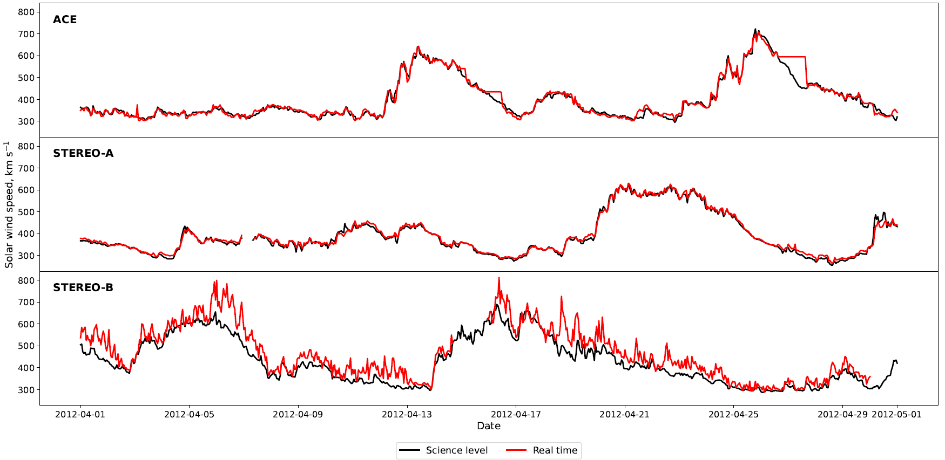
REAL TIME ISSUES

Slide 77
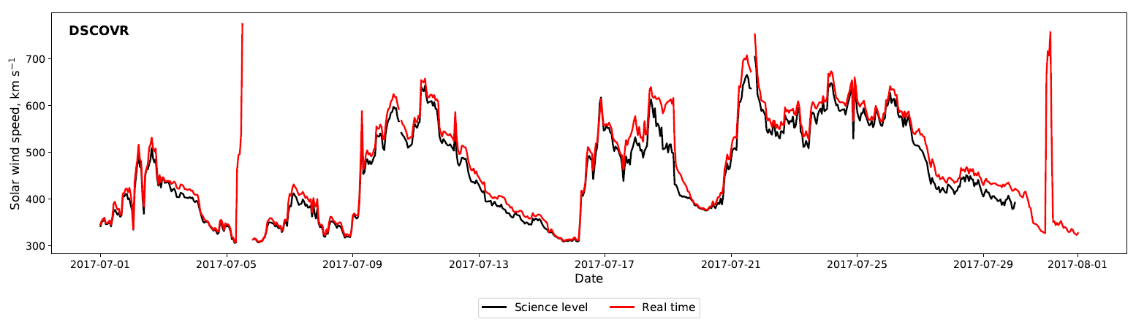
REAL TIME ISSUES

Slide 78
BRaVDA EXPERIMENTS
Assimilating all sources of observations – STEREO-A, B and ACE
Evaluate the forecast accuracy at the three observation locations – verification time series is the science data
Comparing the prior, real time and science forecasts

Slide 79
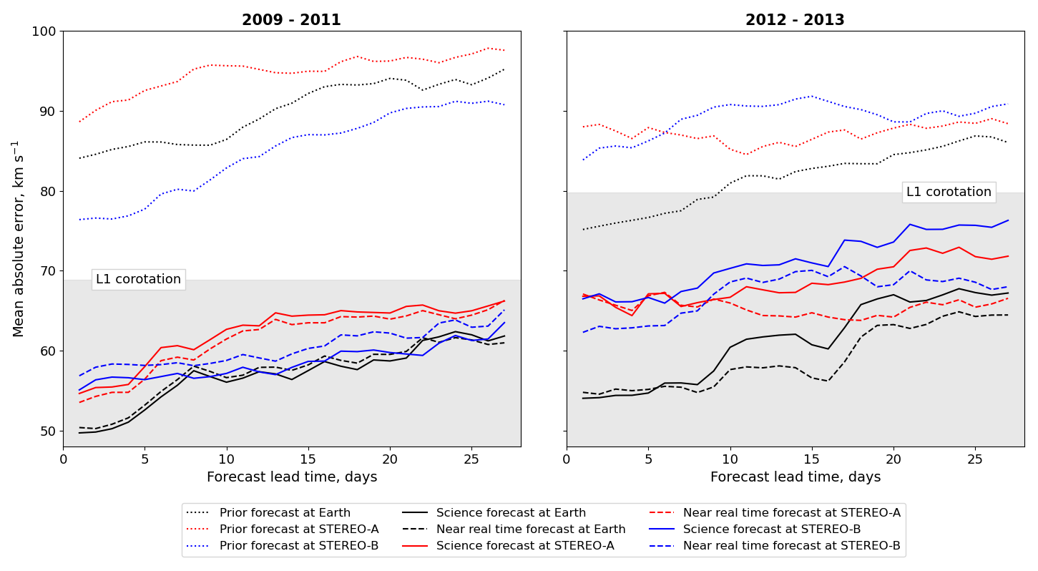
BRaVDA EXPERIMENTS

Slide 80
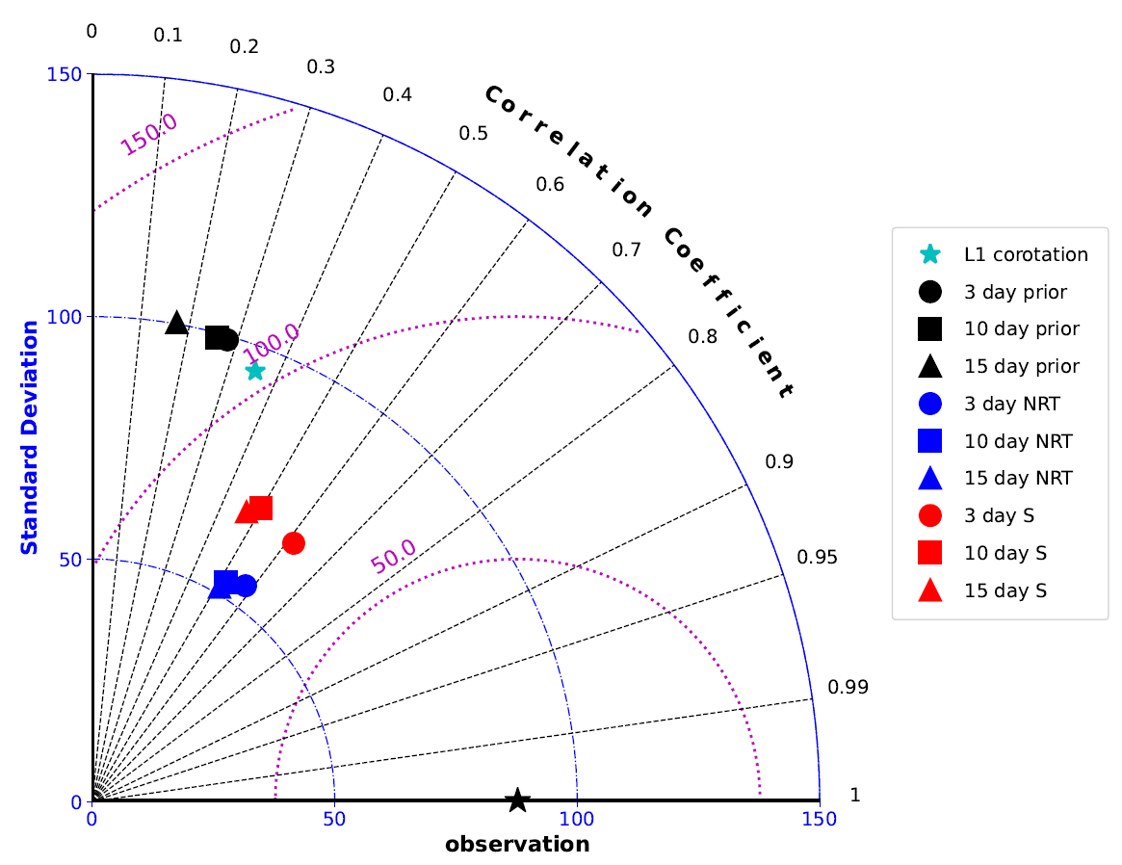
TAYLOR DIAGRAM

Slide 81
TAYLOR DIAGRAM

Slide 82
TAYLOR DIAGRAM

Slide 83
TAYLOR DIAGRAM

Slide 84
TAYLOR DIAGRAM

Slide 85
FUTURE SOLAR WIND DA
The ESA Vigil mission is (hopefully) going to be launched in 2027 (ish) to the L5 point
“The mission will give us advanced warning of oncoming solar storms and therefore more time to protect spacecraft in orbit, infrastructure on the ground and explorers now and in the future, unshielded by Earth’s magnetic field and vulnerable to our star’s violent outbursts.” – ESA, 2023
Could be useful for future operational solar wind DA

Slide 86
L5 & L1 SIMULATION
Combinations of spacecraft separated by approximately 60º in longitude
Historic data to see how well a potential L5 and L1 pairing could work for solar wind DA
4 time periods

Slide 87
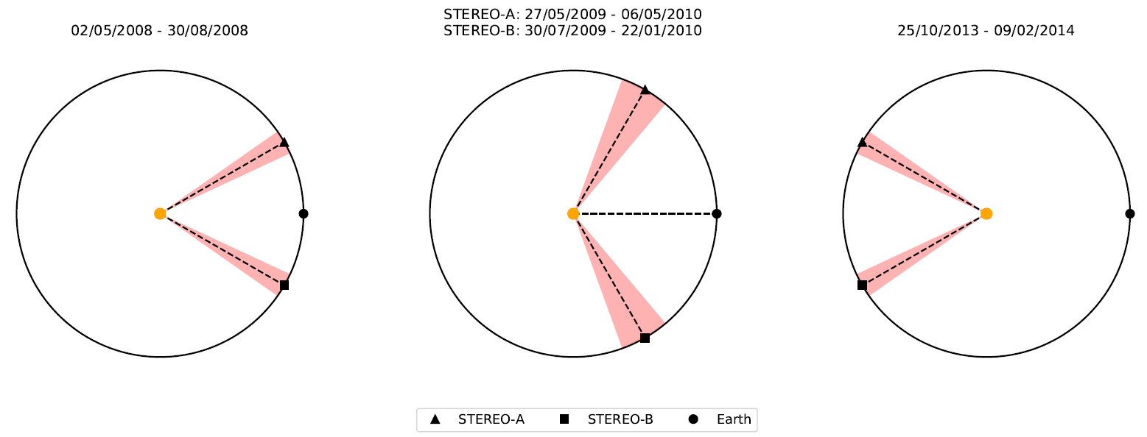
L5 & L1 SIMULATION

Slide 88
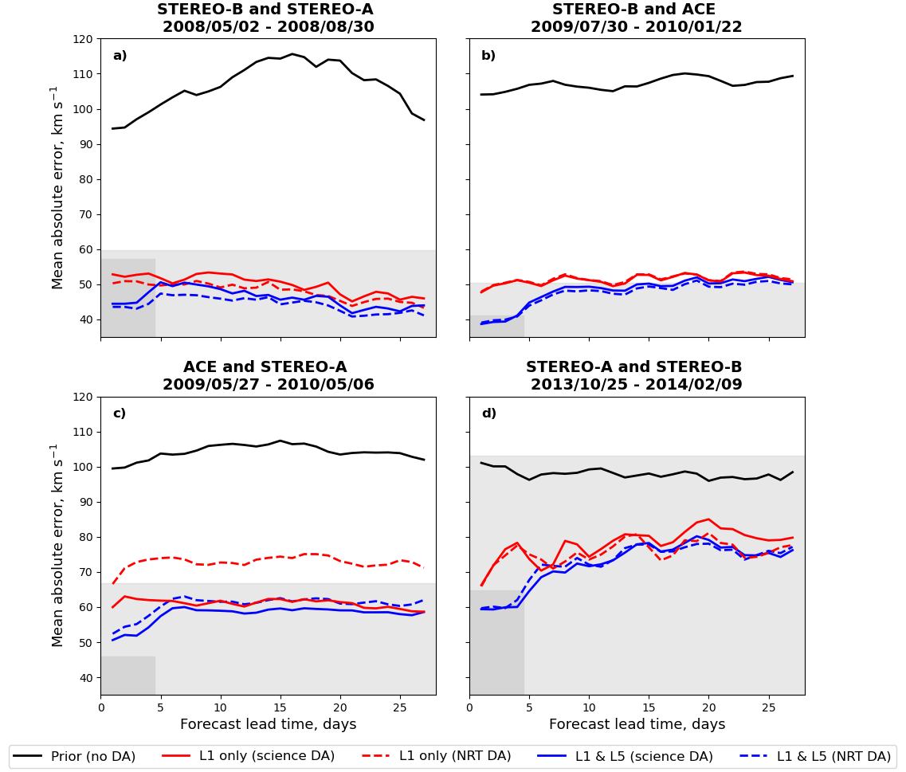

Slide 89
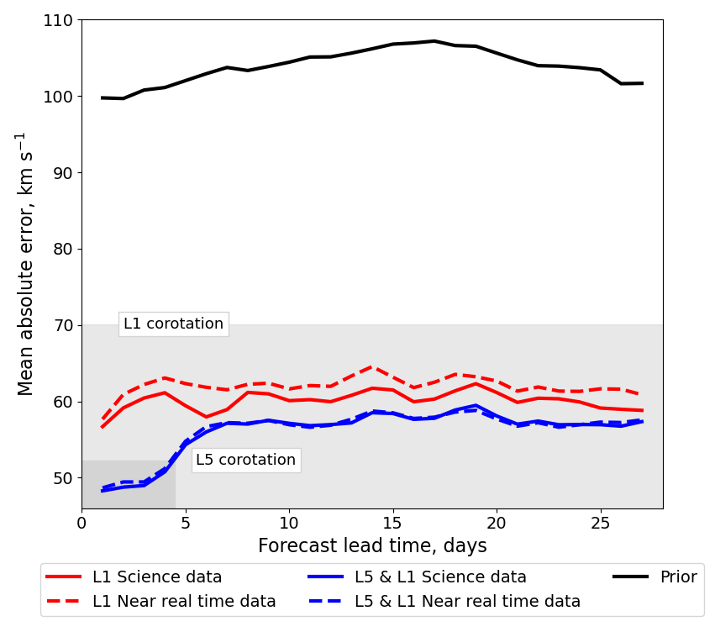
L5 & L1 AVERAGE

Slide 90
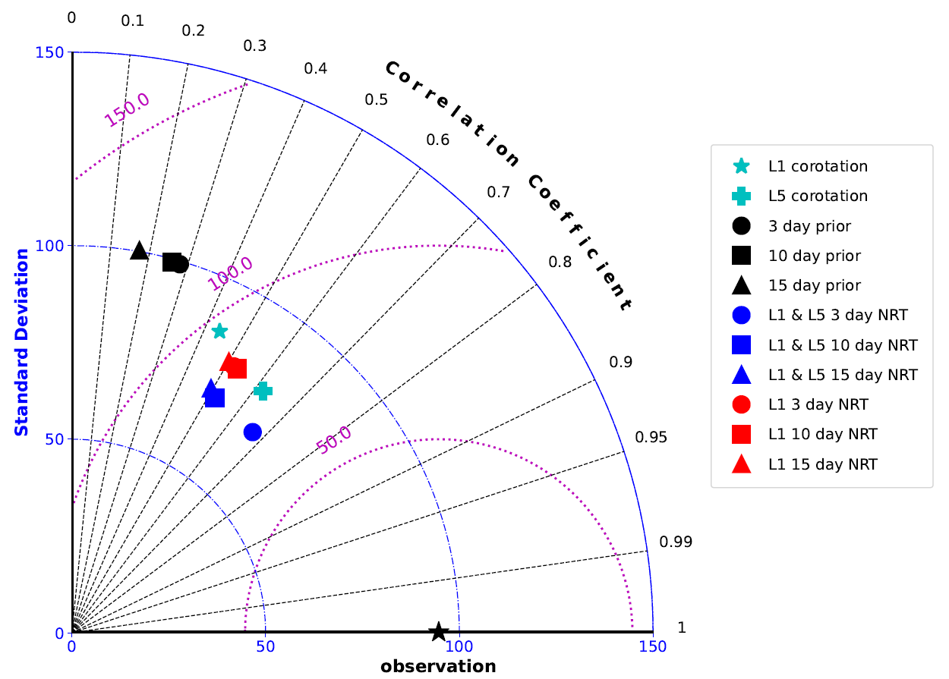
L5 & L1 AVERAGE

Slide 91
L5 & L1 AVERAGE

Slide 92
L5 & L1 AVERAGE

Slide 93
L5 & L1 AVERAGE

Slide 94
OPERATIONAL FORECASTING
Using files from the Met Office and HUXt, we have got BRaVDA running operationally on a routine basis
Still being tweaked and isn’t verified (yet…), but the initial plots are online
Running CMEs through the improved solar wind to give speed and arrival time updates
A world’s first using solar wind DA?

Slide 95
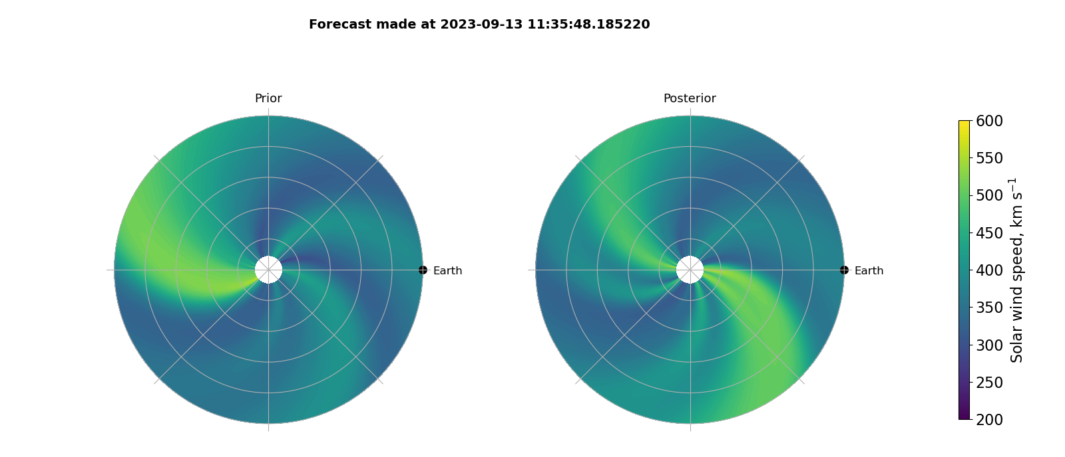

Slide 96
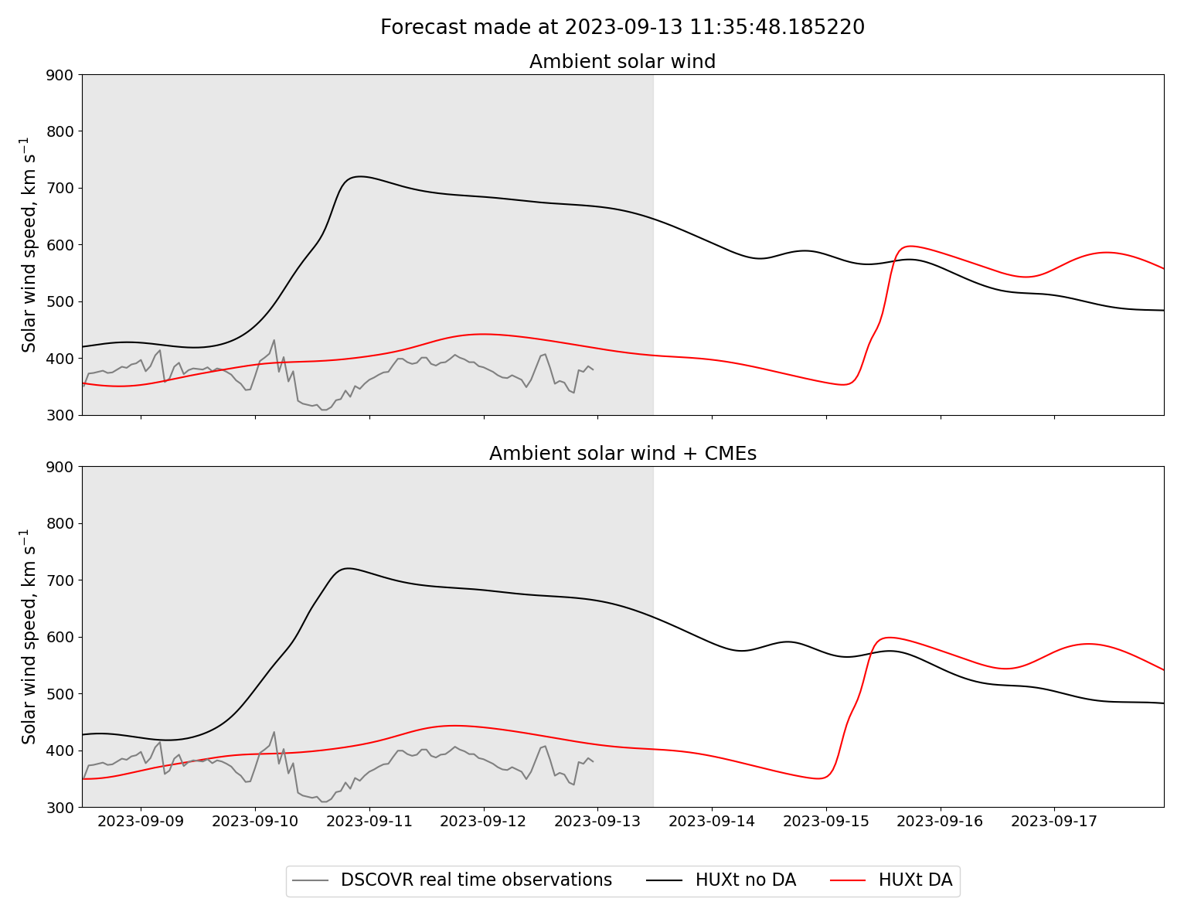

Slide 97
CME EXAMPLE
That example has no CMEs in it, so is a bit boring
The next plot is a forecast from 16th September 2023, which has two CMEs in the Met Office cone file
The CME speed/ arrival time changes are unverified because I just don’t have time right now – this will hopefully form part of my postdoc starting next Spring

Slide 98
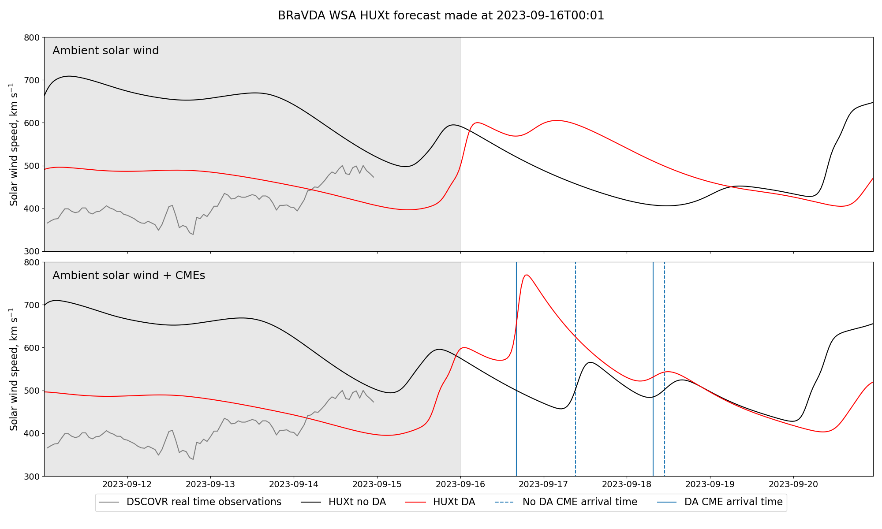

Slide 99
FUTURE WORK
Verification of the solar wind DA forecasts, including a large-scale study of CME speed and arrival time predictions
Hopefully see how using the DA boundary conditions would change when used in MHD models (Enlil, maybe EUHFORIA)
Something about a thesis?

Slide 100
CONCLUSIONS
Knowledge of the solar wind is important for timely and accurate space weather forecasting
The BRaVDA scheme reconstructs a full solar rotation using available observations, leading to improved solar wind forecasts
A future L5 & L1 spacecraft pairing could be useful for operational solar wind DA
BRaVDA is running operationally using HUXt, with future plans to verify the forecasts

Slide 101
REFERENCES
ESA, 2023. URL: https://www.esa.int/Space_Safety/Vigil
Lang, M., & Owens, M. J. (2019). A Variational Approach to Data Assimilation in the Solar Wind. Space Weather, 17(1), 59 – 83. DOI: 10.1029/2018SW001857.
Lang, M., Witherington, J., Owens, M. J., & Turner, H. (2021) Improving solar wind forecasting using data assimilation. Space Weather, 1 – 23.
National Risk Register. URL: https://www.gov.uk/government/publications/national-risk-register-2020
Owens, M. J., et al. A Computationally Efficient, Time-Dependent Model of the Solar Wind for use as a Surrogate to Three-Dimensional Numerical Magnetohydrodynamic Simulations. Solar Physics, 295:43. DOI: 10.1007/s11207-020-01605-3.
Turner, H., Owens, M. J., Lang, M., Gonzi, S., & Riley, P. (2022). Quantifying the effect of ICME removal and observation age for in situ solar wind data assimilation. Space Weather, 20. DOI: 10.1029/2022SW003109.

Slide 102

Paper
Turner, H., Lang, M., Owens, M., Smith, A., Riley, P., Marsh, M., & Gonzi, S. (2023). Solar wind data assimilation in an operational context: use of near-real-time data and the forecast value of an L5 monitor. Space Weather, 21, e2023SW003457. https://doi.org/10.1029/2023SW003457

Slide 103
TITLE
Text

